Slide 1
Editorial heads update
April 1, 2016

Slide 2
New Scientist is dedicated to using data science to develop better products, make business decisions and reach larger audiences.
We have click data, article text data, social network data, email data, subscription data, video data, purchase data, demographic data and mobile data available to us.
We have a large and growing product portfolio that consists of single copies, subscriptions, apps, bundles, event tickets, books, merchandise, advertising and new bespoke audience products in the pipeline.
We leverage this data, along with statistical modelling and machine learning methods to find insights for high-level management and strategy, support technology developments, and create insight to share with editors and writers for content creation.
The goal of this role is to help New Scientist reach a larger audience and develop a more engaged reader base.

Slide 3
Portfolio Metrics

Slide 4
Product Portfolio - w/c March 23rd – last week
Insight | Action
Subscriptions Paid Volume tracking down 3% YOY | Acquisition plan Retention plan Cancellation
New Subscriptions down 1,032 overall Barrier subscriptions down 204 (18% of total) | Acquisition plan Editorial web content strategy & plan Content amplification plan
Registrations up YOY because of change in content strategy – on track for 100k overall | Free Pass campaign Editorial web content strategy & plan Content amplification plan
Web visits down 15% YOY | Editorial web content strategy & plan Content amplification plan Web product development plan
News trade tracking up 6% YOY average 1,299 copies up (22,409 vs. 21,180 STLY) | Magazine content News trade marketing
App sales down 28% | App product development plan
Display Advertising | Under review
New Scientist Jobs/ Recruitment Advertising | Under review

Slide 5
Product Portfolio - w/c March 23rd – last week
Insight | Action
The Collection visits down 96% YOY | Marketing/ Content amplification plan
Events visits down – no events until May | Marketing/ Content amplification plan
New Scientist Live analytics now working on new site – 706 users this week | Marketing/ Content amplification plan
GameChangers 139 visits – need to get download data | GameChangers project group
Travel 373 visits – need to get purchase data | Travel project group
Dating drives 971 per week – who knew? | Under review
Educational Access 180 customers, 1000 visits per week | Marketing plan
Corporate Access new product 100 visits per week | Marketing plan
School scheme/ classroom copies - 28 UK schools | Marketing plan

Slide 6
How we used to measure
 | 2014 ABC Avg. Circ | 2015 ABC Avg. Circ | VAR | VAR%
Print Global Circulation | 113,339 | 105,741 | -7,598 | -7%
Digital Global Circulation | 16,003 | 20,489 | 4,486 | 28%
TOTAL GLOBAL CIRCULATION | 129,342 | 126,230 | -3,112 | -2%

Slide 7
Product Portfolio – Volume of users
Category | Sessions per month
Arc | 5,447
App | 377,401
Commercial projects | 42,447
Editorial projects | 105,063
Events | 6,760
Video | 1,688,816
Website | 3,840,630
Print magazine paid circulation | 126,230
Bookazine | 20,000
All stats from Google Analytics 2013 to Feb 2016 – except print magazine weekly readership figure

Slide 8
I want to make a video channel to attract a younger audience.
How do I measure success?

Slide 9
Video Views by Age
67% of YouTube video views are from under 35’s
YouTube Video Views
Age Demographics– YouTube behaviorally assumed
Source: YouTube Stats 2013 to Feb 2016

Slide 10
We cut from 4 features to 3 features? What is the impact?

Slide 11
Quantity of Features Behind the Barrier
2014 – 4 features per week
2015 – first 4 features per week then cut to 3 features per week in March
2016 – 3 features per week
Confounders:
  Barrier free experiment Feb – March 2014
  Word count on the barrier changed in Nov/Dec 2015 from 170 to 250
  Website redesign
Constant confounders:
  Time
  Multipart feature frequency

Slide 12
Barrier Subscriptions
Week 10 peak in subs and traffic – Bigger than the Higgs article
 | 2016 YTD | 2015 YTD | VAR | VAR%
Barrier Subscriptions CUMULATIVE wk 12 | 732 | 936 | -204 | -22%
Barrier Visits CUMULATIVE wk 12 | 1,204,741 | 1,338,757 | -134,016 | -10%
Barrier subs per week | 61 | 78 | -17 | -22%
Barrier visits per week | 100,395 | 111,563 | -11,168 | -10%
Conversion Rate Avg | 0.06% | 0.07% | -0.01%
Barrier Subscriptions
Barrier Traffic

Slide 13
Where do we go from here?
Visits down 10%, Barrier subs down 22%, Number of stories down 25%
  Assume proportional relationship?
Separating signal from noise:
  Current issue barrier story content each week vs archive
  Promotional effort – take out or account for?
Do we need to benchmark traffic per story type?
  KIM ACTION: Q1 2015 old Q2 2015 – on the old website -

Slide 14
Barrier comparison Q1 vs Q2 2015 on the old site
 | Q1 2015 weeks 1 - 11 | Q2 2015 weeks 12 - 22 | VAR | VAR%
Visits to barrier | 1,247,327 | 1,351,405 | -104,078 | -8%
Barrier Subscriptions | 837 | 1006 | -169 | -17%
Conversion rate
Traffic to current issue features
Archive barrier traffic

Slide 15
How does the volume of content we produce effect the web?

Slide 16
Case Study: This week
Social media posts Twitter + Facebook

Slide 17
I wrote a story about Canada. Did my story do better in Canada?
Why don’t we write more stories about Canada?

Slide 18
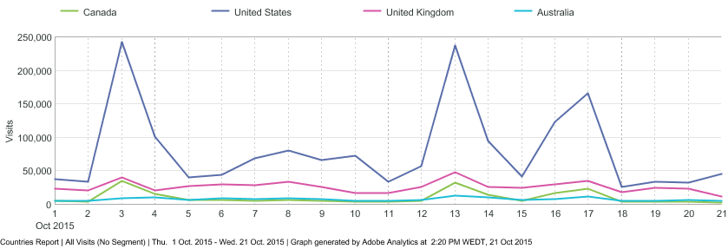
Specifically, in the case of your news story - https://www.newscientist.com/article/dn28372-canadas-new-government-heralds-freedom-of-speech-for-scientists/ there is definitely a Canadian audience skew in that 30% of the traffic to that story came from Canada, whereas normally about 6% of our monthly traffic comes from Canada.
However, in general, Canadian traffic peaks tend to follow global peaks in traffic – see below.
 | Canada | Australia
Subscribers (average active at 2014 mid year) | 4,170 | 11,786
Registered Users (6 months) | 19,587 | 36,384
Unique Visitors website (6 months) | 964,884 | 851,527
Visits website (6 months) | 1,467,768 | 1,481,846
New subscriptions sold online in the last 6 months | 782 | 3,096
Newstrade copies | Less than 300 | 6,822
English speaking Population- rough estimate of market potential | 33,121,175 | 21,394,309
Apple app downloads | 1061 | 3012
Apple single copy sales | 365 | 981
Apple subs sold | 103 | 302
.

Slide 19
We’ve done readership surveys tracking how people read through the magazine.
Do more men or women read my article?

Slide 20





Notes:
Women have 2times the purchasing power within New Scientist UK audience
Over 55+ greatest cohort of users
3rds of retail spending growth will come from shoppers aged 55 plus
Ageing population will transform not only the face, but the role the high street plays in society
With a rapidly ageing population and migration trends changing the ethnic makeup of our cities and towns, UK shopping habits too are beginning to evolve and reflect these wider demographic changes.

Slide 21
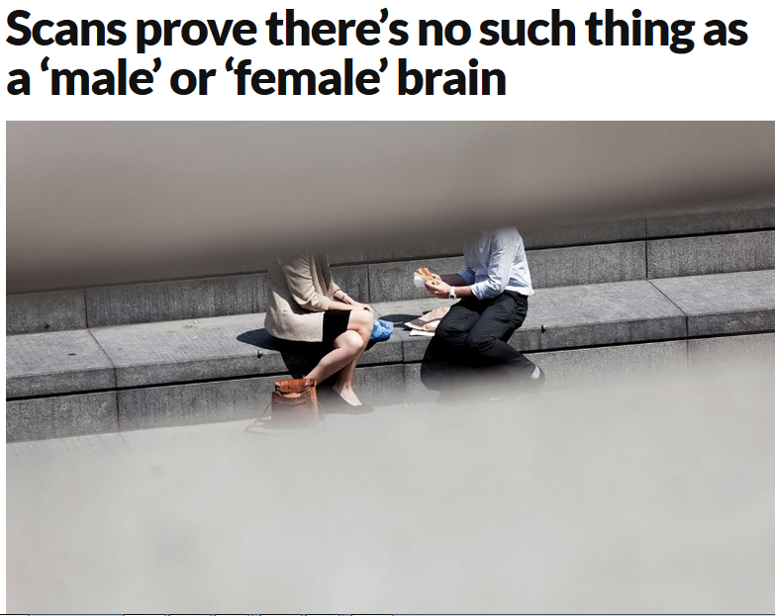
Behavioural marketing/ amplification more effective than demographic targeting?

Slide 22
I want to restructure the Opinion section.
How is the Opinion section doing?

Slide 23
Spike: MPs pass crazy drug law – Free Comment piece by Clare Wilson

Slide 24
When is the best time to post barrier content to make people subscribe?

Slide 25
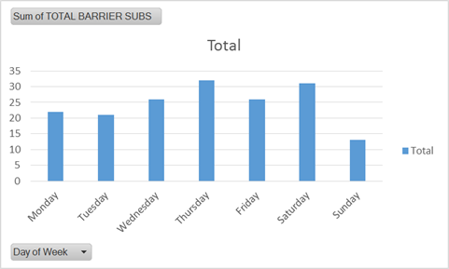
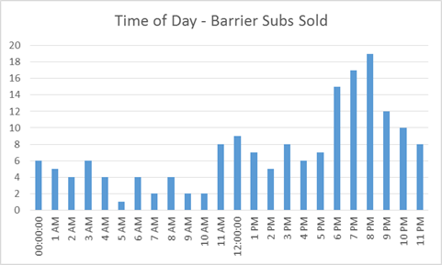
For times/ hours of the day overall GMT 6/7/8pm works best but not sure if it’s the self-fulfilling prophecy based on current content scheduling.

Slide 26
Where do we go from here?
Key questions/ initiatives/experiments?
What information do you need on a regular basis?
What information would be helpful to you?
What’s the best format for doing so? Meeting? Email? Print report? Fridge report – coming back?

Slide 27
More questions
Relationship between number of stories per day and traffic
Social content that works best
Internal website positioning – carousel
Outbrain articles per month - own articles, more money for subscriptions? ?
Average number of page views per stories – pagination?
Reporters & editors- how many page views per week did your story get? Rowan
Events – thinking about topic areas/ subject areas – topic guides
Different subject doing splits – i.e. Mico joining
Are we bringing back fridge stats?
Newstrade LHC?

Slide 28
Google does changing headline penalize SEO? Experiment? Can we boost search traffic?
Cover voodoo
Search voodoo
Mobile/ video traffic changes/ patterns
Long term – digital first – what impact does that have?
Analysis – new section in the magazine – 2 page in the story – engagement
How far did people read? Dwell time? Bounce rate?
Macro: Tech – online - traffic; Analysis – magazine, denser – engagement(time spent on page);
Logged in subscribers vs. registrations
Video – end of April
Niall - news report -

