Slide 1
Agenda
Team
Product Portfolio Review
Subscriptions Marketing
  Volume
    Renewals & Recurring Payments
    Acquisitions
    Cancellations
Audience Development
What’s next

Slide 2
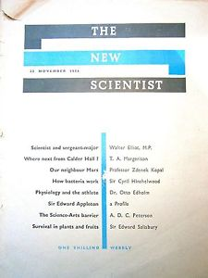












Brand values
Readership of 700,00+ each week globally
Website 3 million monthly users globally
Database 720,000 registered users globally
UK magazine – 45,000 paid subscribers each week
UK newstrade – 28,000 single copy sales each week
3m followers
483k followers
9.3k followers
5k followers
1.8k followers
2m followers
Notes:
History values mission

Slide 3
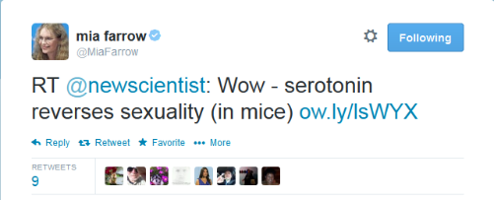

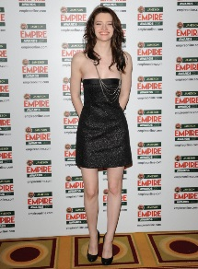
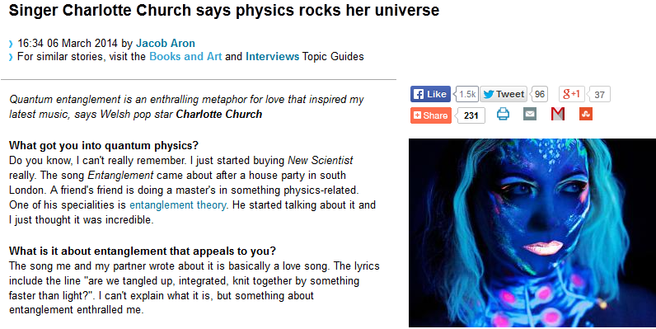
“Are the scientists taking on the bankers?
I think it's a hugely beneficial symbiosis. Are you really from New Scientist? I love New Scientist. What's happening? Do you think we'll have floating frisbees?
Mayor of London, Boris Johnson
“You retweet The New Scientist, unlike any other actress… Whoever does the tweets for the New Scientist has such a sense of humour. It’s a woman, I think, and she’s hysterical. There’ll be a really dry article with such a funny, snide tweet.” Talulah Riley

Slide 4
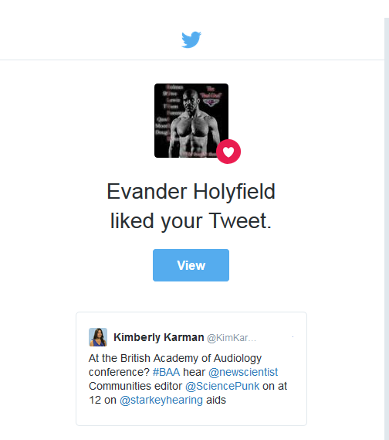
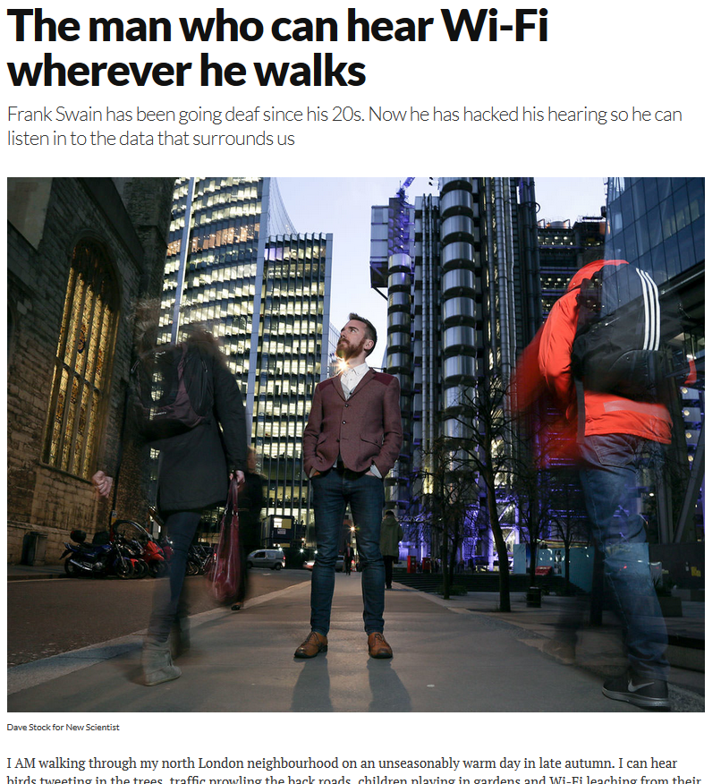

Slide 5
Marketing Overview
Marketing overview
Consumer market & competition
Communication Brand values, Language, Tone, Visual, Content marketing/ amplification
Corporate
HR
Database
Governance
Finance
Technology Systems
Consumer
Geographic
Demographic
Behavioral
Customer Service
Customer Experience
Commodity & Convenience
Product development
Product bundling
Platforms
Cost
Price testing
Pricing plans
Payment methods
Renewals
Channels
Web
PPC
Email
Inserts
House ads

Slide 6


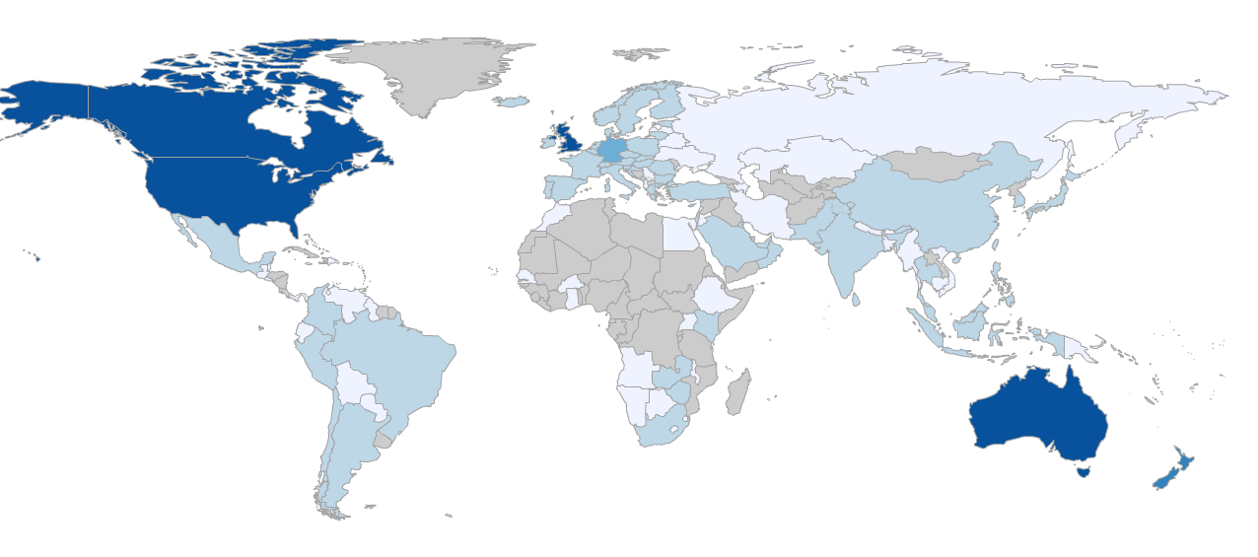


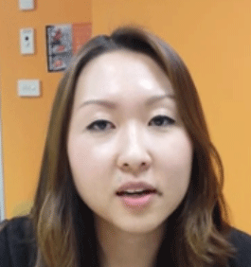



Brand Team
Ben Cordle
Brand marketing team
Marketing Director
Kim
Karman
Michelle Whitfield-Jones
Lucy
Dunwell
Data science & strategy
New Scientist Live
Subscriptions & AU
Danbi
Cho
Sara
Pinotti
David
Hunt
Chloe
Thompson
Subscriptions:
Student
Institutional Subscriptions
Subscriptions:
Apps
Transactional:
Local newstrade & events
Subscriptions:
Consumer & Gift
Transactional:
Bookazines
Books
Events

Slide 7
Marketing Specialist Teams
Demand Center
Search
Conversion
Analytics
Data & Technology
Retention
Ed
Garcia
Barbara Coole
Emma Peskett
Alex Piciu
Matt Lester
Thomas Drury
Joe
Steele-Perkins
Damian Barker
Recruitment
Nicole Celliers
VACANCY

Slide 8


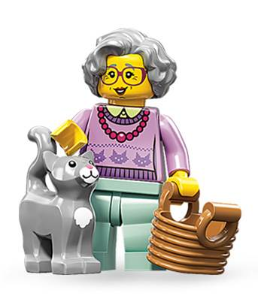

Audience segmentation by persona
23% Professional Scientists
41% Intellectually Curious Business Leaders
14% Students
22% Retired

Slide 9








Persona 1: Scientist
Science
84%
87%
Scientist, engineer or science lecturer
Average age: 51
Proportion of audience:
Characteristics:
High level of science knowledge
Younger
Older
Accounts for 22% of the total audience, this group is declining over time.
Lower level of science knowledge
Why they read NS:
Fit with NS propositions:
Media consumption:
84% read the magazine and 42% use ns.com
More likely to be subscribers than newstrade
Interested in recruitment and academic / funding opportunities
32% would be interested in reading a version of NS optimised for iPad
31% would be interested in reading a version of NS optimised for Kindle
58% would be interested in attending NS events
Magazines:
  34% Scientific American
  28% Nature
  24% Science
  Newspapers:
    Guardian / Independent
    Web usage:
      High, often for research
44% need to keep up to date with science for their work
54% it’s a treat
29% I’ve always read it; it’s a tradition
More likely than the average reader to agree NS is newsy and humorous
Less likely to agree NS is authoritative
Key strength = Variety of content
“New Scientist keeps me abreast of the many disciplines I am interested in, and repeatedly opens up new disciplines to me, as a trusted friend that speaks my language”

Slide 10

Persona 2: Enthusiast
Science
74%
45%
Working in a variety of fields e.g. IT, education and healthcare
Average age: 49
Proportion of audience:
Characteristics:
High level of science knowledge
Younger
Older
Accounts for 40% of the total audience, this group is growing over time.
Lower level of science knowledge
Why they read NS:
Fit with NS propositions:
Media consumption:
81% read the magazine and 45% use ns.com
Many are subscribers but newstrade readers are likely to fall into this group
Interested in the topical main features
33% would be interested in reading more content about the social implications of science
32% would be interested in reading a version of NS optimised for iPad
62% would be interested in attending NS events
Magazines:
  31% Economist
  15% Wired US
  10% Time
    Web usage:
      High, at work and home
      They are likely to visit the BBC, Guardian online, Wired and Twitter
63% say it’s a refreshing alternative to the other things I read
54% it’s a treat
34% I like telling people about what I’ve read
More likely than the average reader to agree NS is authoritative, readable and enjoyable
Less likely to agree NS is newsy
Key strength = Easy to understand
“Reliable source of information which is understandable by those of us who do not have a formal background in science”

Slide 11

Persona 3: Student
Science
60%
25%
Two-thirds undergraduate / A Level
Average age: 24
Proportion of audience:
Characteristics:
High level of science knowledge
Younger
Older
Accounts for 13% of the total audience, this group is declining over time.
Lower level of science knowledge
Why they read NS:
Fit with NS propositions:
Media consumption:
73% read the magazine and 59% use ns.com
Some subscribe but many will buy via newstrade
Interested in recruitment and academic funding
A quarter would be interested in reading more about neuroscience, science policy & funding and threats to science / scientists
36% would be interested in reading a version of NS optimised for iPhone
82% would be interested in attending NS events
Magazines:
  33% National Geographic
  24% Nature
  22% Scientific Americant
    Web usage:
      High, at uni and on mobile devices
      They will be on Facebook and sometimes Twitter
      They are likely to visit the BBC
42% need to keep up to date with science for their work
62% it’s a treat
47% I like telling other people about what I’ve read
More likely than the average reader to agree NS is attractive and modern
Less likely to agree NS is authoritative & newsy
Key strength = Concise / Accessible
“Succinct articles keeping me up to date with the latest information but without being too heavy and feeling like I am reading journal after journal.”

Slide 12

Persona 4: Retired
Science
85%
64%
Average age: 67
Proportion of audience:
Characteristics:
High level of science knowledge
Younger
Older
Accounts for 21% of the total audience, this group is increasing over time.
Lower level of science knowledge
Why they read NS:
Fit with NS propositions:
Media consumption:
88% read the magazine and 28% use ns.com
More likely to be subscribers than newstrade
Spend longest reading the magazine of all reader groups
Are generally happy with the mix of content in the magazine
22% would be interested in reading a version of NS optimised for Kindle
42% would be interested in attending NS events
Magazines:
  38% Scientific American
  30% National Geographic
  24% The Economist
  11% Time
  Newspapers: Broadsheets
    Web usage: Low-moderate, may browse newspaper sites or SciAm
36% I’ve always read it; it’s a tradition
54% It’s a refreshing alternative to the other things I read
More likely than the average reader to agree NS is authoritative, informative and newsy
Less likely to agree NS is modern
Key strength = Credibility / Keeps me up to date
“An overview of what's going on in science in sufficient detail to make it intelligible to a retired scientist who doesn't want to be regarded as an out-of-touch dinosaur.”

Slide 13


Notes:
Women have 2times the purchasing power within New Scientist UK audience
Over 55+ greatest cohort of users
3rds of retail spending growth will come from shoppers aged 55 plus
Ageing population will transform not only the face, but the role the high street plays in society
With a rapidly ageing population and migration trends changing the ethnic makeup of our cities and towns, UK shopping habits too are beginning to evolve and reflect these wider demographic changes.

Slide 14
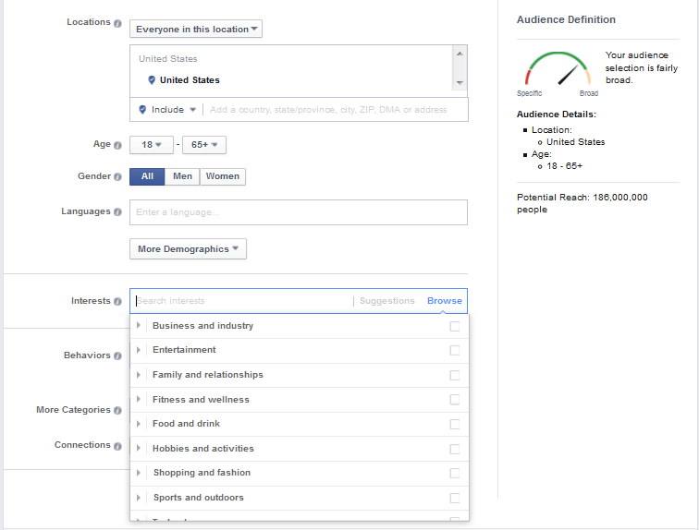

Slide 15
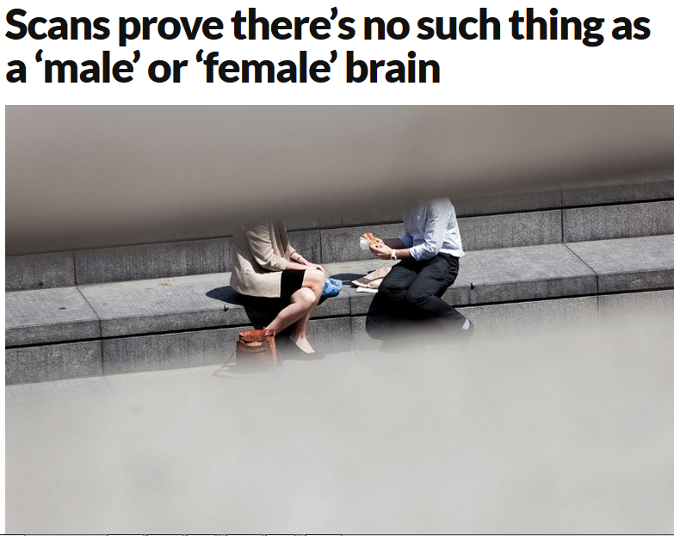

Slide 16

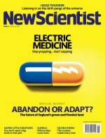

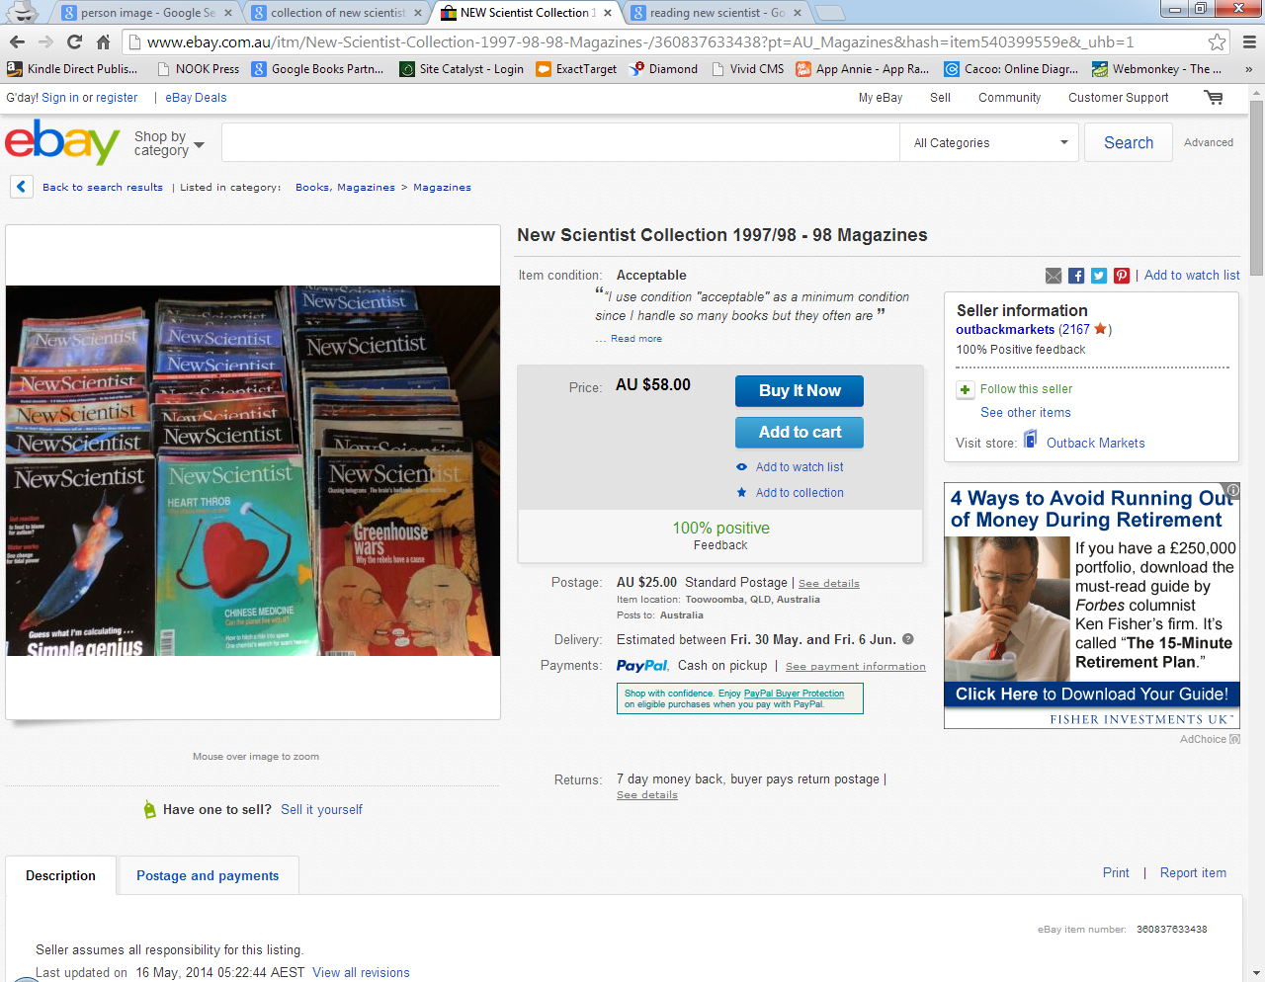
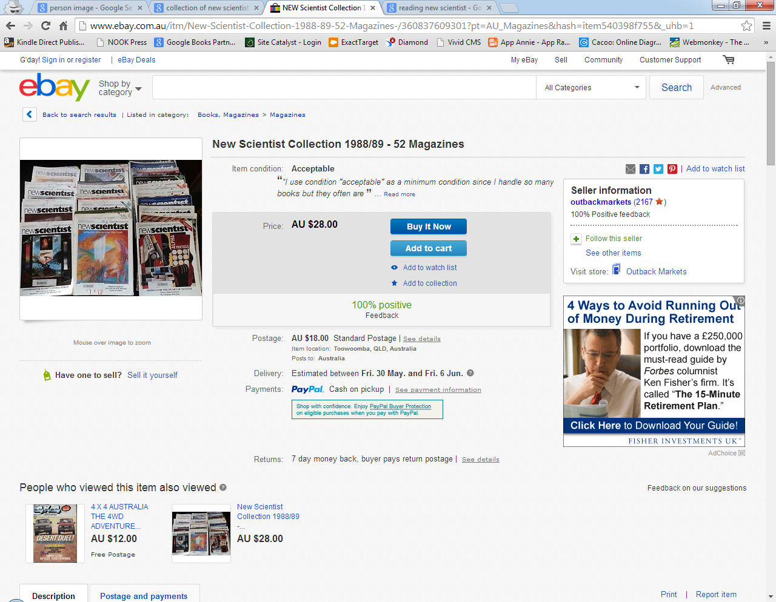
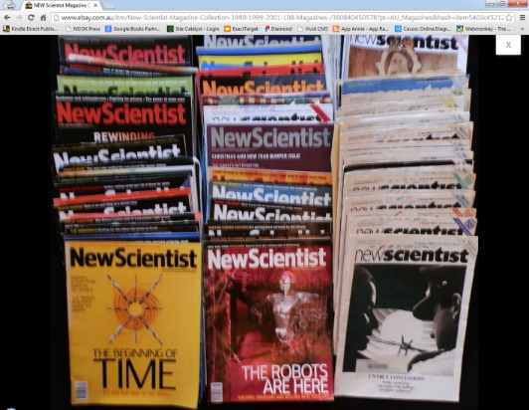
Actions speak louder than words
Behaviour speaks louder than demographics
The Collection
Notes:
The purpose of this new revenue stream is to offer something exciting for our core audience who already pay for New Scientist, whilst also exposing more people to the brand through content they might not expect from us.
As a print product it’s priced at £9.99 which is considerably higher than the weekly magazine (heard earlier), but at 128 pages (more than twice the amount of content) and better paper and nicer binding, it feels more collectable and of a higher quality.
CLICK
This appeals to the “collectors instinct” inherently within the New Scientist reader. They’re keen to own something that’s designed as collectable that they can hold onto, with the feeling more precious than a standard issue. The higher price point reinforces this value.
Display advertising in the product provides an additional revenue stream, with 7 ad slots to sell and £4,500 revenue generated from this first issue.
Print distribution has been through the standard New Scientist retail channels, but...
…with the largest proportion of our audience being online globally, we’re limiting ourselves with an inherently UK facing print product - CLICK

Slide 17
Registered User Conversion
Cohort conversion rates pattern is follows cyclical content led pattern
Registered users from 2012 still go on to subscribe 3 years later

Slide 18
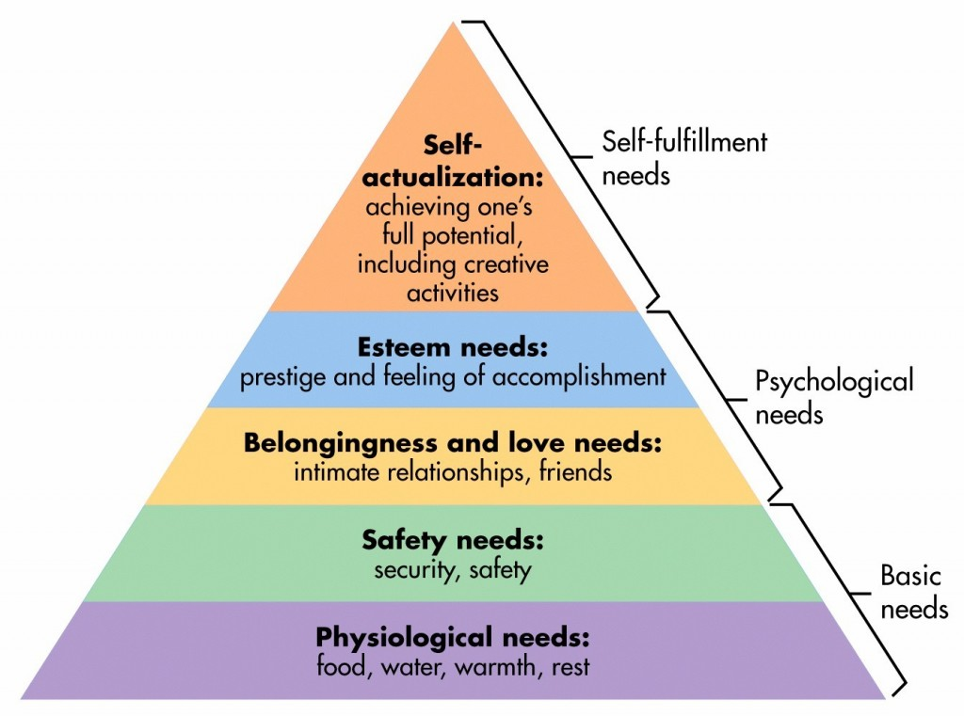
How did you make your customer feel?

Slide 19

Communication methods
Face to face
- Events, meetings
- Richest form of communication
Verbal
Phone
Highest levels of dishonest
Written
Email
Documented – highest level of reserve
Web chat
Social media
Text message
Social media

Slide 20

Primo Levi – The Periodic Table

Slide 21
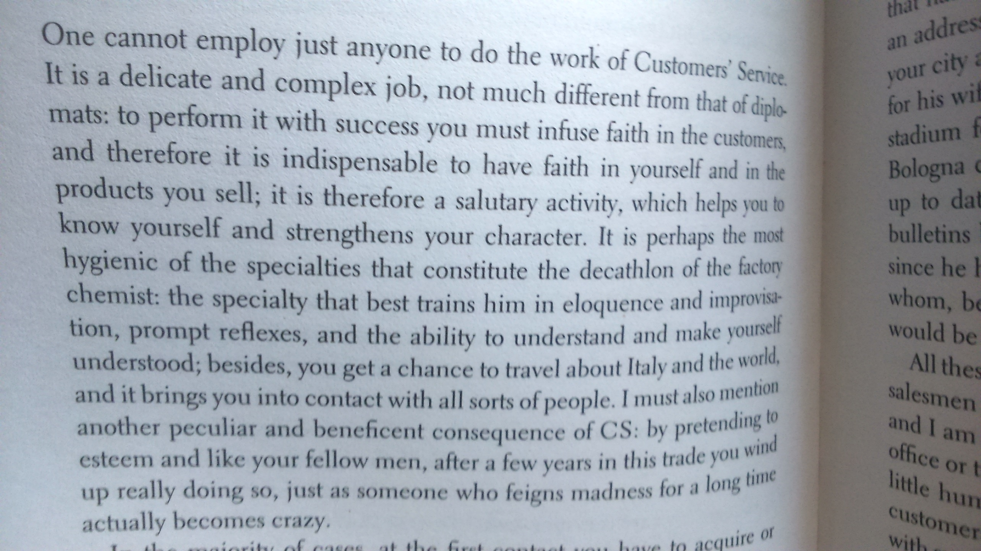
Notes:
Primo Michele Levi (Italian: [ˈpriːmo ˈlɛːvi]; 31 July 1919 – 11 April 1987) was an Italian Jewish chemist, writer, and Holocaust survivor. He was the author of several books, novels, collections of short stories, essays, and poems. His best-known works include If This Is a Man (1947) (U.S.: Survival in Auschwitz), his account of the year he spent as a prisoner in the Auschwitz concentration camp in Nazi-occupied Poland; and his unique work, The Periodic Table (1975), linked to qualities of the elements, which the Royal Institution of Great Britain named the best science book ever written.^{[1]}

Slide 22
KPI Metrics – 2015 Year End
 | 2015 | 2014 | VAR | VAR%
Revenue | £10,918,514 FX – £11,175,514 | £11,068,874 | -£150,360 | -1%
Paid Subscriber Volume | 87,298 | 87,255 | 43 | 0%
Acquisitions - NS | 24,035 | 26,783 | -2,748 | -10%
Acquisitions – Third Party Digital | 5,177 | 6,935 | -1,758 | -25%
Total New Acquisitions | 29,212 | 33,718 | -4,506 | -13%
Renewal Rate | 66.72% | 67.41% | -0.69%
Renewal Volume | 31,703 | 31,500 | 203 | 1%
Cancellation Volume | 15,657 | 19,788 | -4,131 | 21%
Barrier Subscriptions | 3,264 *prom codes 3,348 **web codes | 2,150* 2,872** | 1,114 **476 | 52% 17%
Subscriptions from registered user emails | 799 | 992 | -193 | -19%
Subscriptions from newsletter | 713 | 980 | -267 | -27%
Subscriptions from social | 901 | 848 | 53 | 6%
Registrations | 55,675 | 60,146 | -4,471 | -7%
Visits per month | 3,727,911 | 3,783,410 | -55,499 | -1%
Unique users per month | 2,909,132 | 2,772,319 | 136,813 | 5%

Slide 23
 | 2016 | 2015 | VAR | VAR%
Revenue | £10,851,012 Adjusted: £10,665,898 | £10,918,514 FX – £11,175,514 | -£67,502 -252,616 | -1% -2%
Paid Subscriber Volume | 87,624 Adjusted: 86,193 | 87,298 | 326 -1,104 | 0% -1%
Acquisitions - NS | 26,000 | 24,035 | 1,965 | 8%
Acquisitions – Third Party Digital | 5,177 | 5,177 | 0 | 0%
Total New Acquisitions | 31,177 | 29,212 | 1,965 | 7%
Renewal Rate |  | 66.72%
Renewal Volume |  | 31,703
Cancellation Volume |  | 15,657
Barrier Subscriptions |  | 3,264
Subscriptions from registered user emails |  | 799
Subscriptions from newsletter |  | 713
Subscriptions from social |  | 901
Registrations |  | 55,675
Visits per month |  | 3,727,911
Unique users per month |  | 2,909,132

Slide 24
Paid Subscriber Volume
 | Paid Volume | VAR
2014 | 87,255
2015 | 87,297 | 43
2016 BGT | 87,624 | 326
2016 Adjusted | 86,193 | -1,104

Slide 25
Revenue by Product
2016 BGT entered in August 2015
2016 Adjusted reflects FX as of January 20, 2016 + school scheme phasing
 | 2014 | 2015 | VAR | VAR% | 2016 BGT | 2016 Adjusted | VAR | VAR%
UK/ROW | 7,370,653 | 7,428,557 | 57,904 | 1% | 7,434,206 | 7,434,206 | 5,649 | 0%
US | 1,429,744 | 1,345,756 | -83,988 | -6% | 1,348,996 | 1,173,850 | -171,906 | -13%
AU | 1,788,982 | 1,647,771 | -141,211 | -8% | 1,548,410 | 1,517,442 | -130,329 | -8%
Zinio | 106,276 | 125,397 | 19,120 | 18% | 108,296 | 108,296 | -17,101 | -14%
Archive | 168,076 | 161,656 | -6,420 | -4% | 166,500 | 166,500 | 4,844 | 3%
Web Pass | 112 | - | -112 | -100% | - | - | 0 | 0%
Apple | 123,354 | 144,955 | 21,601 | 18% | 153,608 | 153,608 | 8,653 | 6%
Google | 25,749 | 27,686 | 1,938 | 8% | 36,000 | 36,000 | 8,314 | 30%
School Scheme | 55,927 | 36,736 | -19,191 | -34% | 54,996 | 75,996 | 39,260 | 107%
TOTAL | 11,068,874 | 10,918,515 | -150,359 | -1% | 10,851,012 | 10,665,898 | -252,616 | -2%

Slide 26
Acquisitions by Channel
 | 2015 | 2014 | VAR | VAR%
Web | 11,036 | 13,434 | -2,398 | -18%
Apple | 1,711 | 2,916 | -1,205 | -41%
Email | 1,526 | 2,225 | -699 | -31%
Zinio | 1,868 | 2,412 | -544 | -23%
PPC | 3,664 | 4,163 | -499 | -12%
Agents | 397 | 617 | -220 | -36%
Inserts | 1,370 | 1,523 | -153 | -10%
Google Play | 148 | 180 | -32 | -18%
Windows | 19 | 10 | 9 | 90%
Android | 1,431 | 1,417 | 14 | 1%
House Adv | 164 | 135 | 29 | 21%
Other | 2,614 | 2,536 | 78 | 3%
Web - Barrier | 3,264 | 2,150 | 1,114 | 52%
TOTAL | 29,212 | 33,718 | -4,506 | -13%
Note – this is a YOY comparison – not a before and after website analysis;
Web down YOY
Web barrier up YOY but was trending higher in H1 2015
Apple has not had push notifications all year, 2014 did have push

Slide 27
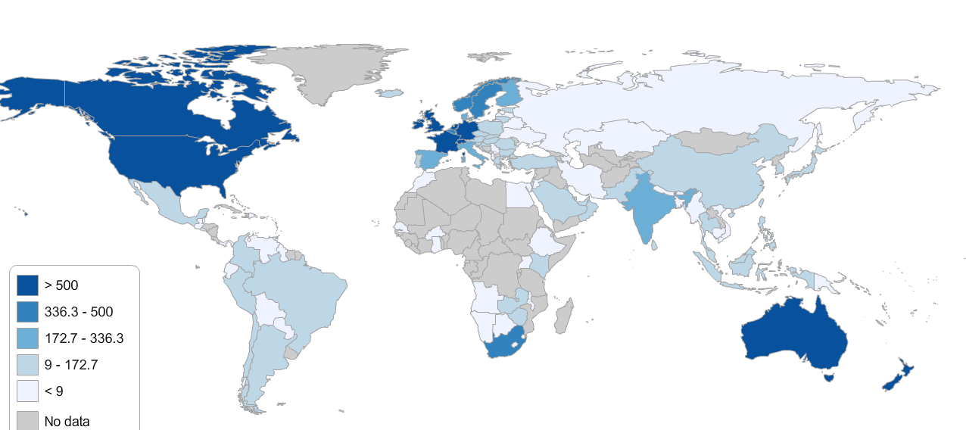
Global Subscribers
KEY: Paid Subscribers
>500
336 – 499
173 – 335
9 – 172
< 9
No data

Slide 28
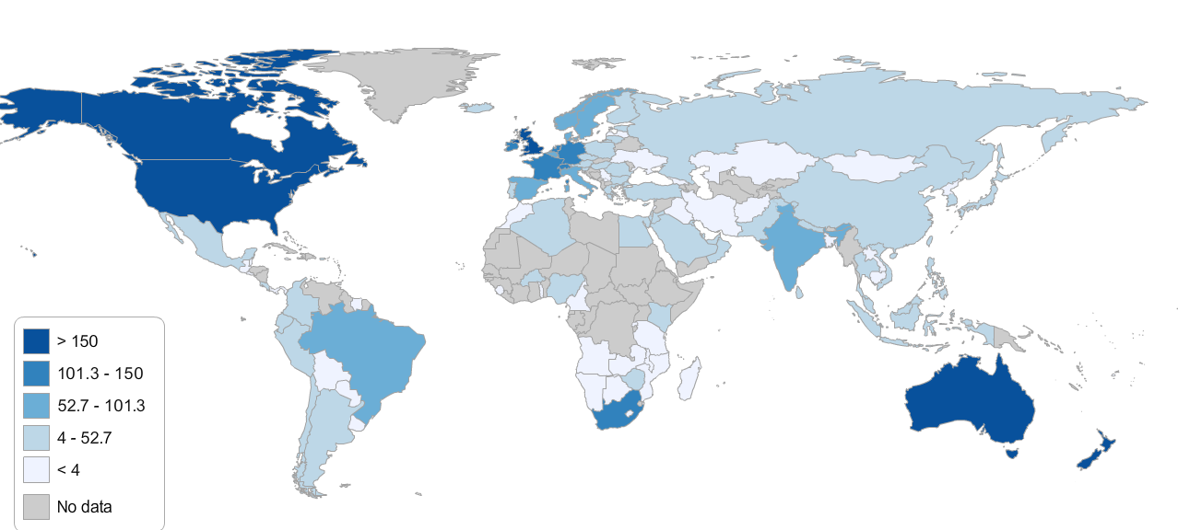
Global New Subscribers
KEY: Subs sold in the last 6 months
>150
101 – 150
53 – 100
4 – 52
< 4
No data

Slide 29
SUBSCRIPTION PRODUCTS

Slide 30
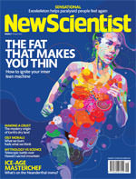
Product – Print
NPS Score 55
Superb magazine with well written articles Excellent quality of reporting Variety of articles Accurate / unbiased reporting | Sometimes hard to find articles featured on the home page More descriptive diagrams as opposed to artwork Expensive
Print | Q1 2015 | Q1 2014 | VAR %
Avg Volume | 75,921 | 80,579 | -6% (-4658)
% Total #’s of audience | 86% | 92% | -6%
Q1 | Q2 | Q3 | Q4
Production switch Delivery issues – fixed Contact number – fixed | Update contact info Behavioural targeting Letters page updated Cartoon added | Print sampling | Prep for Christmas

Slide 31
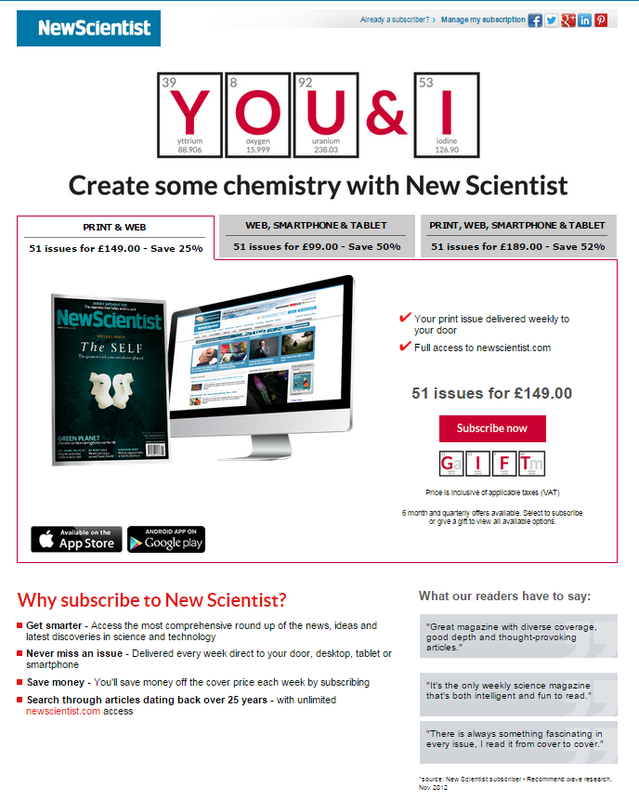
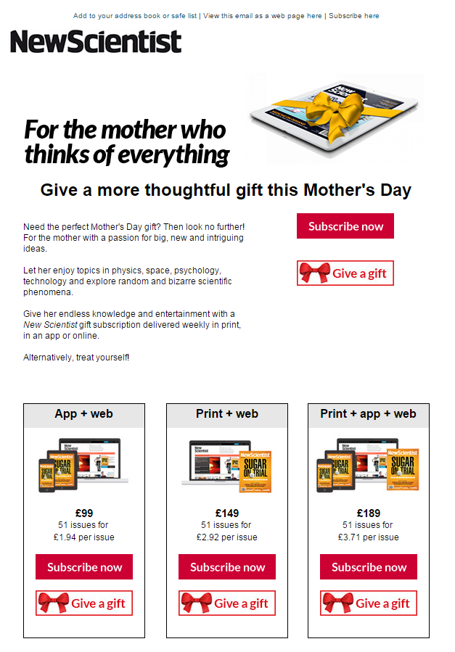
Product – Gift Subscriptions
Print or digital magazine subscription as a gift
New acquisitions
+14%
Q1 | Q2 | Q3 | Q4
Valentines Day Mother’s Day | Father’s & Mother’s Day Gift subscription process | Christmas Prep | Christmas

Slide 32
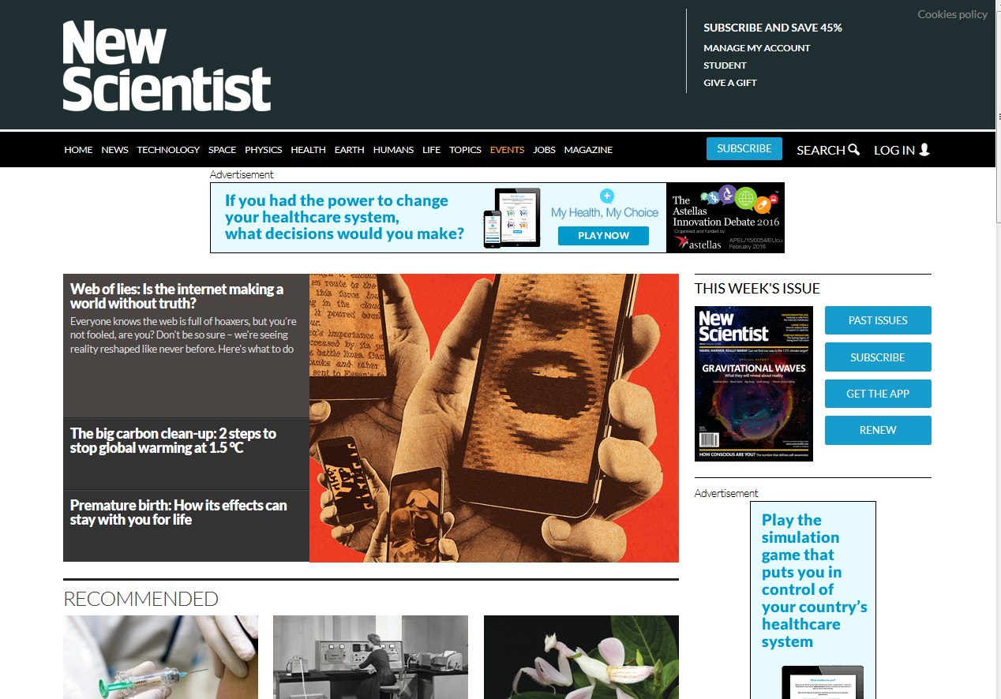
Product –Website
Users: 9,036,774 (+34% YOY)
Page views: 21,472,902 (+17% YOY)
New vs Returning
Device Usage
Age
Region
*Source: Google Analytics, Jan-Mar 2015

Slide 33
Product – Website
New site launch – invitations to subscribers and registrants on April 29th
User feedback:
Magazine-like layout Clean Simple / basic Like the images Interesting headlines | Very slow to load Too much grey Too many ads
Q1 | Q2 | Q3 | Q4
Development | Testing and implementation | Testing and implementation | No major site changes - Xmas / Black Friday

Slide 34

Product – Institutional Subscriptions
Subscriptions for an organization, school or university
Goal: increase awareness and usage within institutions with a free 1 month trial
Improve UX: customers still asked to subscribe on website when using institutional subscription, and user journey is convoluted
Volume
Q1 | Q2 | Q3 | Q4
Institutional subscription review | Institutional Subscription campaign email and telemarketing campaign; Better user journey for institutions on new site | Free to Schools campaign: offering newscientist.com free to all UK state schools

Slide 35
Product – Student Subscriptions
Discounted print subscription to students
Back to school / uni promotions in August
Optimised user journey for students on new site
2014
2015
New acquisitions
+14%
Q1 | Q2 | Q3 | Q4
New student rates for 2015 | Student campaign planning | Back to school / university promotions in August | Pricing review for 2016

Slide 36
Product – School Scheme
Teachers purchasing classroom copies
Currently 45 customers
Discount level of 60% but for bulk purchases (10+ copies)
Declining revenue stream but sizable (41k budget)

Slide 37
Product – Apps
 | Apple App | Android App | Windows 8 app | Zinio | Google Play Magazines | Google Currents
Active Users | 33,981 | 16,545 |  |  | 600 | 208,585
Sessions | 191,065 | 184,753 |  |  | 3,130 | 612,131
Sessions Per User | 5.62 | 11.16 |  |  | 5.21 | 2.93
Conv Rate | 1.46% | 2.29% |  |  | 6.17% | 0
New Acq | 498 | 379 | 6 | 485 | 37 | 0
Time Spent | 9:58 | 6:18 |  |  | 11:01 | 2:33
NPS Score | 26 | -8 |  | 46
Q1 | Q2 | Q3 | Q4
Reporting | Push implementation CST training | Push testing Acquisition campaign | Christmas sales

Slide 38
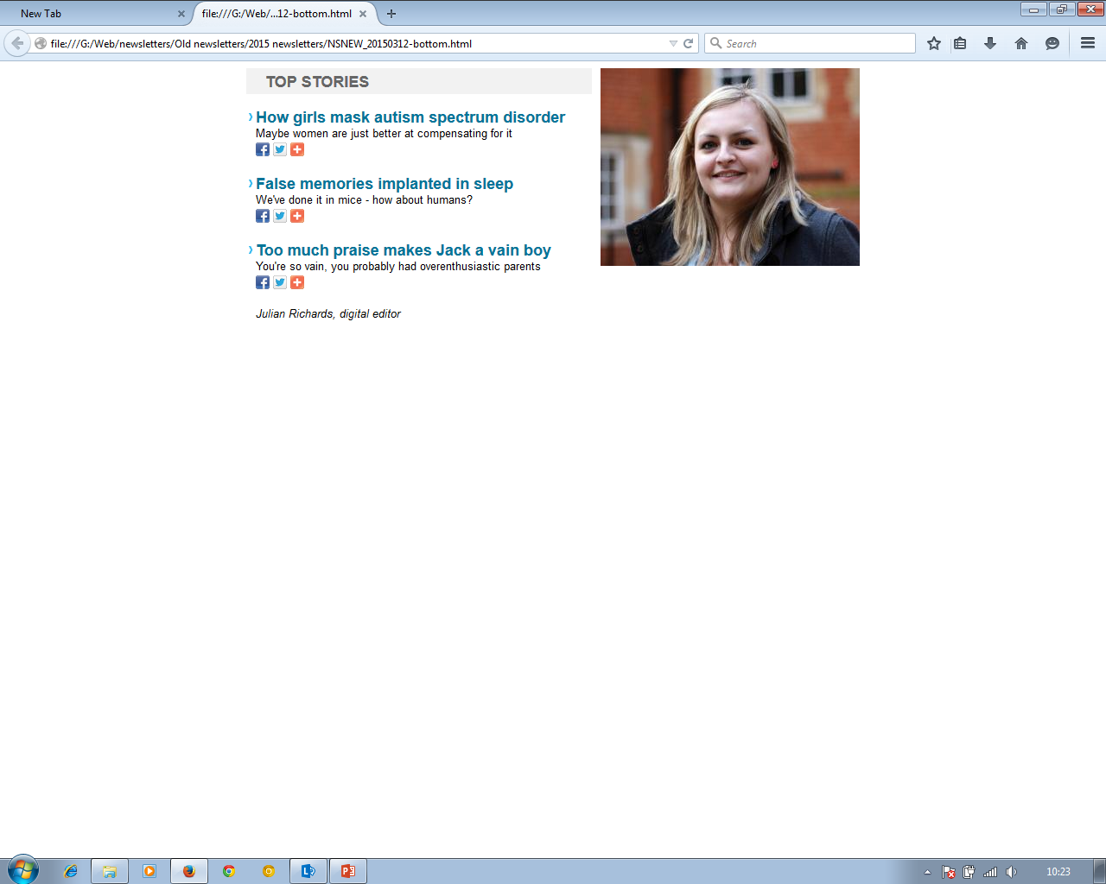
Product – Email newsletter/ registered user
Registrants | 170,573
Subscribers | 23,364 | 26% of paid users
Q1 | Q2 | Q3 | Q4
Process efficiency | Analysis & conversion optimization | Email redesign Registration open house Data capture experiment

Slide 39
TRANSACTIONAL PRODUCTS

Slide 40
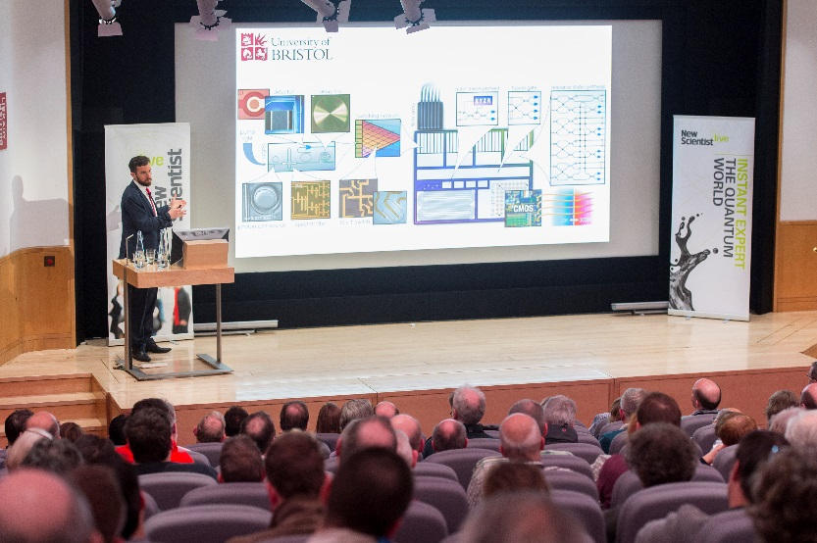
Product - Events
New Scientist Live events in 2015 - globally
255 customers in February (£25k revenue)
Rest of 2015:
  UK – 1,020 potential customers (£108k potential revenue)
  AUS – 1,910 potential customers (AUS$36k potential revenue)
To improve customer needs:
  Improved web presence for New Scientist Live
  Implement proper data collection to allow those interested in
  events to stay informed and allow for improved marketing both
  in 2015 and for the big event in 2016.
Customer quotes (from Instant Expert: The Quantum World):
  “Amazing array of speakers and different perspectives on the subject, great day overall”
  “Very excellent day and I would certainly be interested in a future event (e.g. on relativity)”
  “I would just like to say - thank you very much for a fabulous day at the Quantum World event. I bought tickets for my family - my son now wants a subscription to New Scientist”
Q1 | Q2 | Q3 | Q4
21 Feb – Instant Expert: The Quantum World (London) | 7 Apr – Consciousness & the extended mind (Edinburgh) 7 May – Resurrecting Australia’s extinct animals (Sydney) 23 May – Instant Expert: Einstein’s Universe (London) | 9 July – The fishy origins of sex (Sydney) 20 Aug – Quantum computing & teleporting (Sydney) 12 Sep – Instant Expert: Consciousness (London) | 28 Oct – The origins of modern humans (Sydney) 14 Nov – Instant Expert: The Quantum World 2 (London) 28 Nov – Instant Expert: Einstein’s World 2 tbc (London)

Slide 41


Product - Books
Books published by New Scientist in 2015
Question Everything (published 6 Nov 2014)
  Continues to sell extremely well, now having sold more copies in print than Nothing (published 7 Nov 2013) has sold in its entirety:
    47,494 copies sold (Bookscan) vs 46,386 copies of Nothing (sold since launch)
    2,945 Ebook copies sold (Amazon) vs 6,604 total copies of Nothing sold
Know It All (published 24 Feb 2015)
  North American version of Question Everything, rebranded to Know It All by the US publishers The Experiment (who also published Nothing in North America).
  Print ad running in the US edition of the magazine – online advertising space offered (to run as a house ad) but no creative supplied by publisher.
Reader comments about Question Everything:
  “I've bought every one of the New Scientist's books and everyone, including this, has been excellent” [sic] – Amazon UK 5* review
  “Very understandable answers to a lot of tricky questions. A delight to read” – Amazon UK 5* review
Q1 | Q2 | Q3 | Q4
24 Feb – Know It All (US version of Question Everything) published |  | July - summer reading promotion of Question Everything | 5 Nov – (tbc) Chance book published

Slide 42
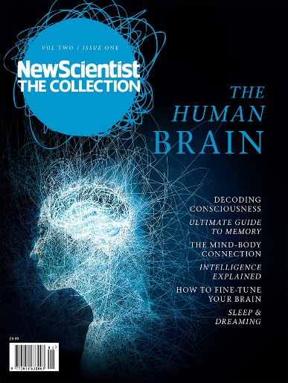
Product - Bookazines
New Scientist: The Collection The Human Story (published 22 Oct 2014):
  closed in March on 12,651 print copies, the highest of any 2014 issue.
The Human Brain (published on 4th Mar 2015):
  6,926 print copies sold in 26 days, tracking ahead of all 2014 issues.
  736 digital copies sold in first month on sale (ahead of issues 2 & 4)
Digital sales 2014 issues:
Projected revenue for 2015: £378k
Plan to make print back issues easy to purchase (through QSS)– this is the most frequent request from customers who are unable to find these once a new issue is out.
2014 issues | The Human Story (Oct – Mar) | Scientific Guide To A Better You (Aug - Mar) | The Unknown Universe (Jun – Mar) | The Big Questions (Mar – Mar)
Kindle | 527 | 929 | 1,248 | 2,132
Zinio | 269 | 217 | 185 | 622
Apple | 207 | 722 | 336 | 631
Android | 20 | 98 | 37 | 53
TOTAL | 1,023 | 1,966 | 1,806 | 3,438
Q1 | Q2 | Q3 | Q4
4 Mar - vol 2, issue 1: The Human Brain | 13 May – vol 2, issue 2: Medical Frontiers | 22 Jul – vol 2, issue 3: Being You 30 Sep – vol 2, issue 4: Our Planet | 9 Dec – vol 2, issue 5: Instant Expert

Slide 43
Product - Merchandise
T-shirts, bags
Historical online store www.cafepress.com/newscientist

Slide 44
Product - Syndication
Tribune Media Services
Copyright licensing of articles, images, videos

Slide 45


Product – Display Advertising
Product – Recruitment Advertising

Slide 46
Product – New Scientist Live

Slide 47
Revenue = Yield x Volume of Customers
Price/ Product Choice Acquisitions Exchange Rates Renewals
Tax Recurring Payments
Cancellations

Slide 48


UK Subscriptions
44,902 active subscribers
Average order value of £137 per subscription

Slide 49
ROW Subscriptions
9,718 active paid subscribers
Average order value of £139

Slide 50
US Subscriptions
19,604 active paid subscribers
Average order value of £72

Slide 51
AU Subscriptions
14,217 active paid subscribers
Average order value of £121

Slide 52
Paid Subscriber Volume - Direct

Slide 53
Overall renewal rate over time
 | End 2011 | End 2012 | End 2013 | End 2014 | End Q1 2015
Expires | 76,789 | 70,547 | 79,706 | 76,723 | 79,652
Renewed | 49,112 | 46,679 | 52,788 | 52,684 | 53,648
Renewal % | 63.96% | 66.17% | 66.23% | 68.67% | 67.35%

Slide 54
Barrier & Web Subscriptions By Month
The time illusion (51), Let them eat steak (45), Gravity’s secret (38)
Algorithms (26), Brain boosting (25), Rules of attraction (25)
Migraine (137), Chance (63), Know it all (44)
Barrier
New acquisitions
+6.8%
+0.7%
+18.6%

Slide 55
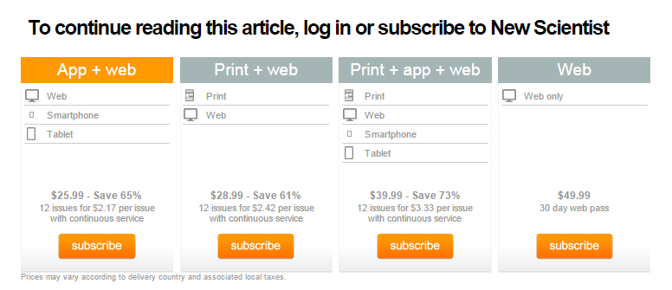
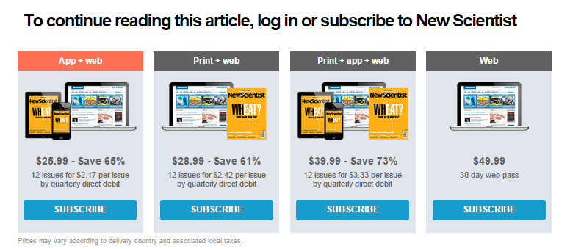
Barrier Test
Pricing, Products, Positioning
Do images on the barrier increase conversion rate?
November 12th 2014 – March 3rd 2015
Original barrier: 0.073% conversion rate
Test barrier: 0.065% conversion rate

Slide 56
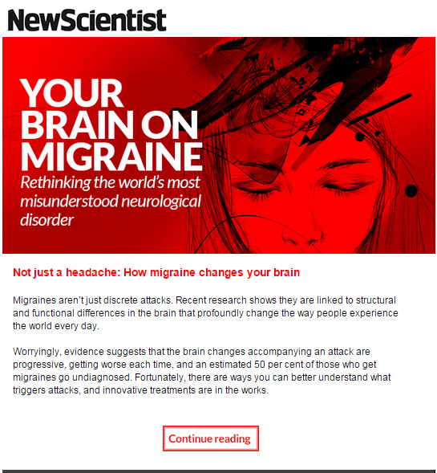
Content Campaigns

Slide 57
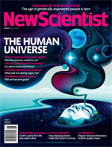
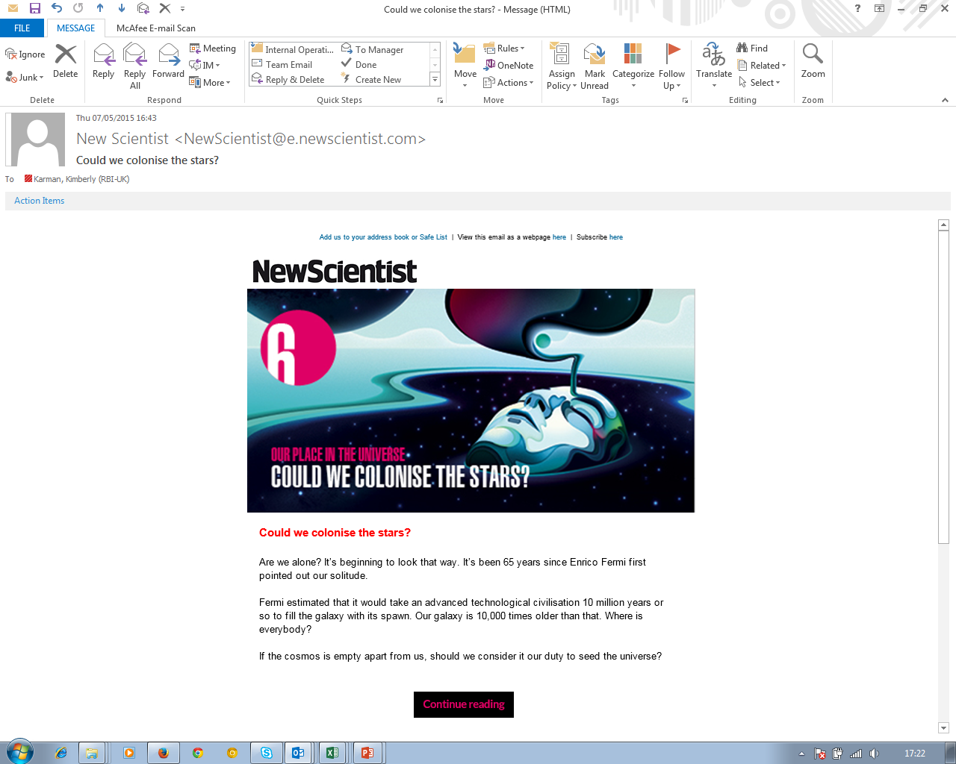
Human Universe
Content | Visits | Subscription | Conversion Rate
sub|The human universe: Was the cosmos made for us? | 23,545 | 43 | 0.182629
sub|The human universe: Could we destroy the fabric of the cosmos? | 19,584 | 22 | 0.112337
sub|The human universe: Does consciousness create reality? | 18,085 | 48 | 0.265413
sub|The human universe: If aliens exist, do they know we're here? | 11,979 | 12 | 0.100175
sub|The human universe: Can we understand everything? | 10,461 | 17 | 0.162508
sub|The human universe: Could we engineer the galaxy? | 8,524 | 3 | 0.035195
sub|The human universe: Could we become gods? | 4,981 | 0 | 0
sub|The human universe: Could we colonise the stars? | 4,705 | 0 | 0
sub|The human universe: Exploring our place in space | 647 | 0 | 0
Total | 89,067 | 145 | 0.162799
Email promotions: 88
Social media: 8
Web: 49

Slide 58
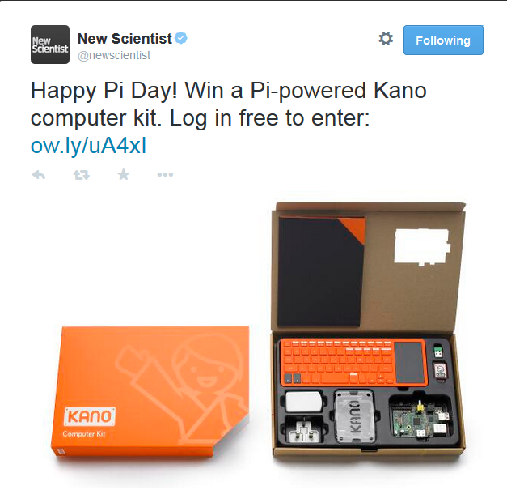
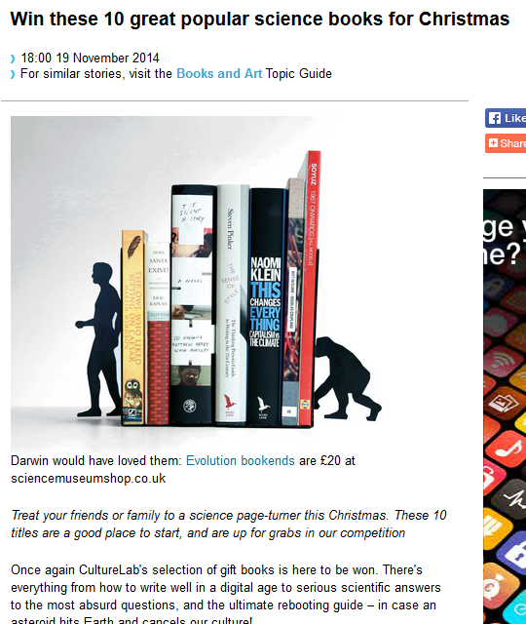
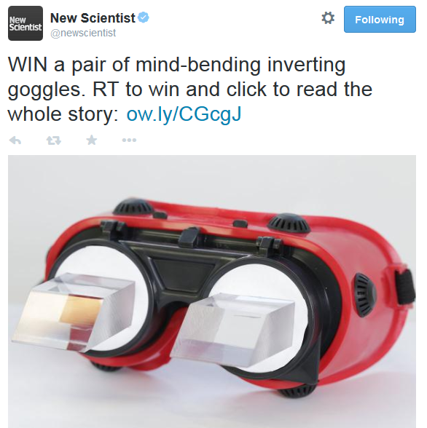
Engagement & acquisition

Slide 59
Registered User Conversion
Cohort conversion rates pattern is follows cyclical content led pattern
Registered users from 2012 still go on to subscribe over 2 and a half years later
September 2014 highest conversion volume to date but February cohort still has 1 month to go

Slide 60
Registered User Conversion
 | 2013 | 2014 | 2015 Current | 2015 Proposed - Inbound
New Registrants | 80,336 | 60,146 | 62,984 | 79,680
Subscriber Volume | 748 | 992 | 1,274 | 1,427
Cohort Conversion | 0.14% | 0.14% | 0.14% | 0.14%
Underlying Registration Volume (yearly average) | 260,817 | 139,165 | 182,000 | 203,850

Slide 61
Audience Development
 | Apr-15 | Mar-15 | MOM VAR | MOM VAR % | Apr-14 | YOY VAR | YOY VAR %
New Subscriptions Sold Online | 1,589 | 1,959 | -370 | -19% | 1,747 | -221 | -9%
Barrier Subscriptions | 357 | 416 | -59 | -14 | 234 | 264 | 35%
Registrations | 6,050 | 5,830 | 220 | 4% | 4,793 | 1,091 | 26%
Visits | 4,378,541 | 4,305,772 | 72,769 | 2% | 4,166,605 | 255,533 | 5%
The top selling stories for April were Brown Fat (74), I Believe (61) and The Greatest Physics Theorem You’ve Never Heard (41).
There were no multi-email campaigns this month. Instead, there were several pushes for individual features in single/double story emails – this included successful Hayfever/Migraines and Brown Fat/Doomed to be Fat emails, which brought in an additional 20 subscriptions by using archive content.
Registrations this month were dominated by the camera competition (2,840). The stories which drove the most registrations were AD 536 (461), Win a Photograph Capturing the Beauty of Science (432) and Defrosting History (151).
Key drivers on free content reach
Is this ET? Mystery of strange radio bursts from space was the top story of the month driving 450K visits, 36.9% of which came from the Drudge Report pick up
Baboon bone found in famous Lucy skeleton article received the second highest page views with 243K, 33% of which came from Reddit

Slide 62
Subs Conversion by Domain
 | Subs Volume
google.co.uk | 1,283
google.com | 484
googleadservices.com | 433
google.com.au | 372
facebook.com | 207
t.co | 202
 | Conv Rate
googleadservices.com | 2.050286472
google.com.au | 0.269260836
google.co.nz | 0.233830223
google.be | 0.169779287
google.co.uk | 0.162744354
bing.com | 0.147993796
Typed/Bookmarked | 0.11758232
t.co | 0.027873757
yahoo.com | 0.020310512
google.com.my | 0.018191741
indeed.co.uk | 0.012897235
google.com.pk | 0.012208522
facebook.com | 0.011181157
iflscience.com | 0.004852131
Users from Facebook convert 10x more than reddit
Users from Facebook convert 4x more than IFLScience

Slide 63
Traffic from domain

Slide 64
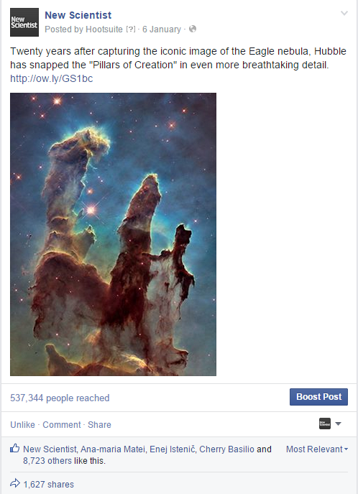
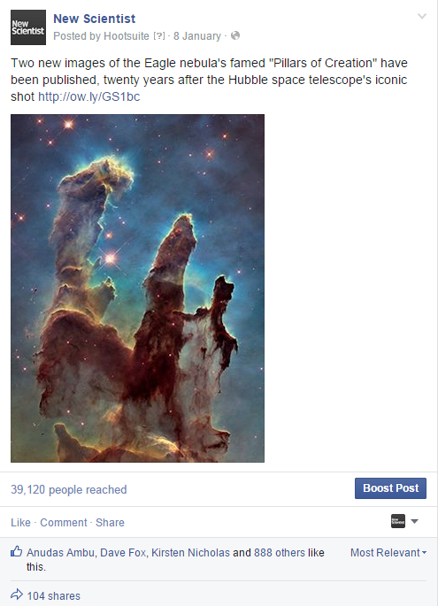
537,344 impressions
39,120 impressions

Slide 65
How does type of post affect reach?

Slide 69
How many times should we push articles?

Slide 70
Relationship between different measures
Should we pursue likes, shares, comments?
Should we pursue retweets, favourites, replies?

Slide 73
Cancellation Saves Program

Slide 74
2016 Marketing Initiatives
Customer Relationship Management
Subscriptions Acquisition – the more you know, the more you can sell
Customer engagement & retention
Programmatic advertisement – cross platform and cross functional use of data
New product development

Slide 75
Guiding principles
Every customer is the only customer
Our readers are diverse
Regional products available
Singular New Scientist voice
Create products that customers want
Monetize new products separately
  Incremental value in increased yield per subscriber
  Incentivize current users over new users to retain customer loyalty and increase advocacy
Partners need to add value and align with our vision and values

Slide 76
Customer Data Experiments
Criteo search & social– cross platform marketing
Push & email – cross platform marketing
Data capture on registration
Multiple product portfolio efficiencies

Slide 77
Any questions?

