Slide 1
Website strategy
March 11th, 2016

Slide 2
Background
Experiment – February – March 2014
Data point – July 2015
Twitter 1 million

Slide 3
What happens when we make the site free?
Hypothesis:
  Traffic will increase
  registrations will increase after - uplift
  subscriptions will increase after - uplift

Slide 4
Experiment
February 2014 – 4 weeks worth of current issue content was made completely free
March 2014 – experimented with variables of cover feature vs. three features
April 2014 – back to standard barrier format

Slide 5
Results
 | 2014 Experiment |  |  |  |  |  | FREE vs. BARRIER
 | Free current issue content | cover or 3 features free | 4 weeks after | Average full year | Standard Deviation |  | VARIANCE
Visits | 952,589 | 912,623 | 976,879 | 871,640 | 241,213 |  | +80,949
Registrations | 437 | 1,620 | 994 | 1,156 | 506 |  | -719
Subscriptions | 421 | 394 | 431 | 508 | 215 |  | -10
There was no demonstrable increase in traffic to justify the decline in subscriptions when the website went free or when less features where put behind the barrier
CONCLUSION – Put barriers back up and push

Slide 8
Data point to consider
July 2015 website relaunch – barriers down for 2 weeks

Slide 9
Results
 | 2015 Experiment |  |  |  |  | FREE vs. BARRIER
 | Barriers down 2 weeks | After | Average full year | Standard Deviation | After after website - no Christmas | VARIANCE
Visits | 731,039 | 819,429 | 860,084 | 223,181 | 818,708 | -87,669
Registrations | 604 | 263 | 1,077 | 506 | 766 | -162
Subscriptions | 313 | 420 | 486 | 183 | 450 | -137
There was no demonstrable increase in traffic to justify the decline in subscriptions when the website went free or when less features where put behind the barrier
CONCLUSION – Put barriers back up and push

Slide 10
Registration Cohort conversion
- Need to measure and any free pass promotion should impact 1. registration volume 2. comparative registration cohort conversion to subscriptions

Slide 11
Impacts barriers
Average of 100k visits per week to subscription barrier currently
  50k current issue content
  50k long tail of archive content
  0.06% conversion per week
  60 subscriptions per week
Average of 40k visits per week to registration barrier
  5% conversion rate average
  2k new registrations per week

Slide 12
Points to measure
If one of the biggest sources of new audiences to either archive or current issue content is from SEO, what is the impact?
If one of the biggest sources of new audience is from social media, what is the impact of unlocking more content to them?

Slide 13
Registration persuasion architecture
Already area opportunities to make this better – currently down average of 15 subscriptions per month from My Account area
Current customer complaints about Login cookie working long term

Slide 14
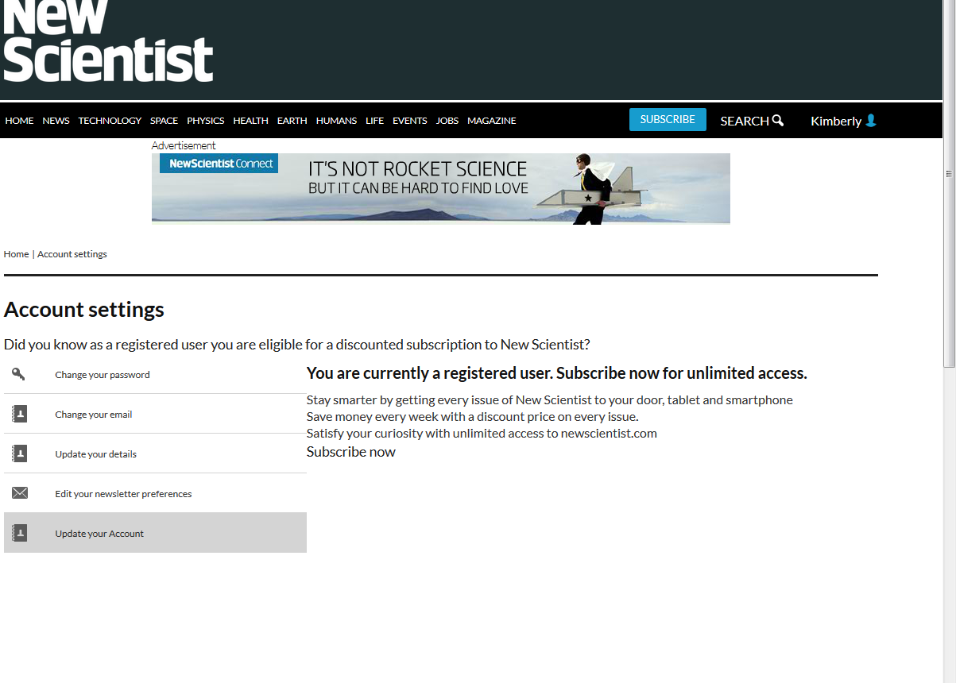
Registered user persuasion architecture

Slide 15
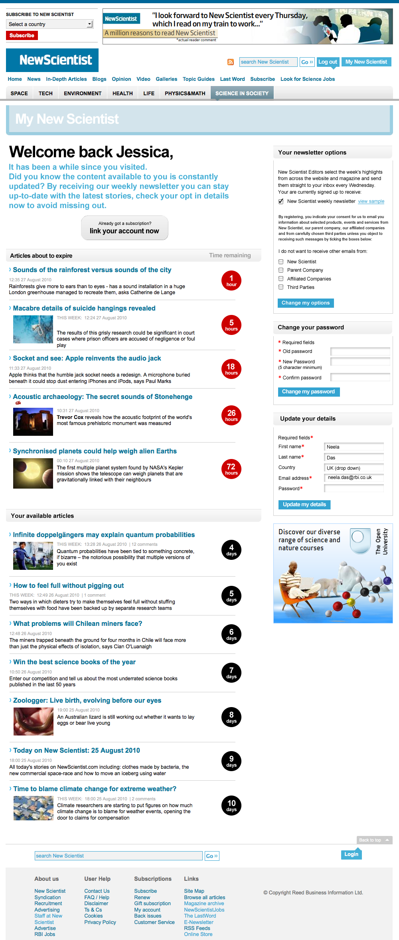
Registered user persuasion architecture

Slide 16
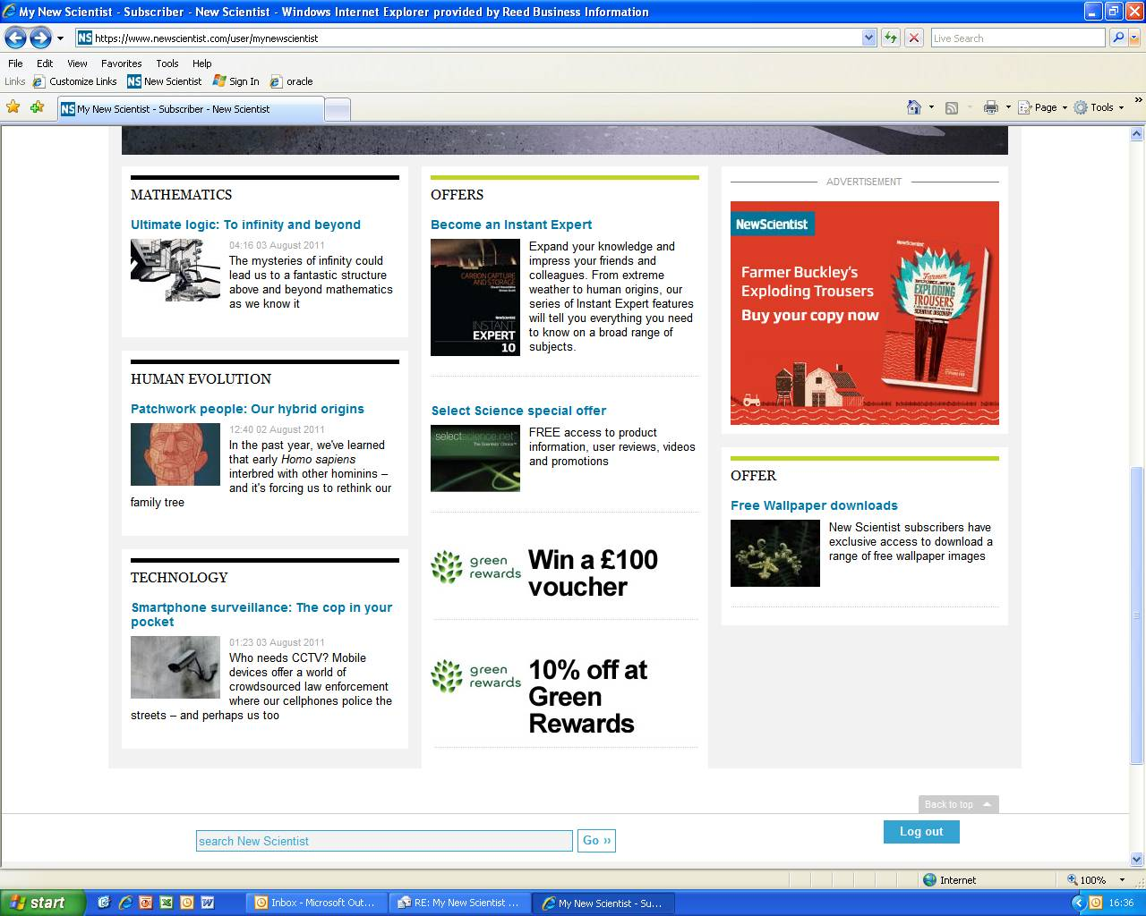
Logged in subscriber homepage

Slide 17
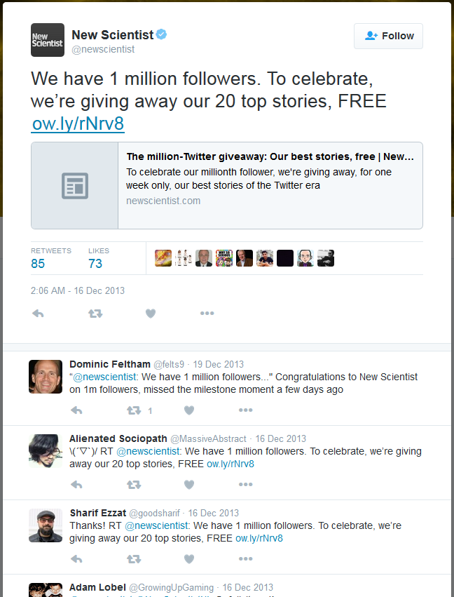

Slide 18
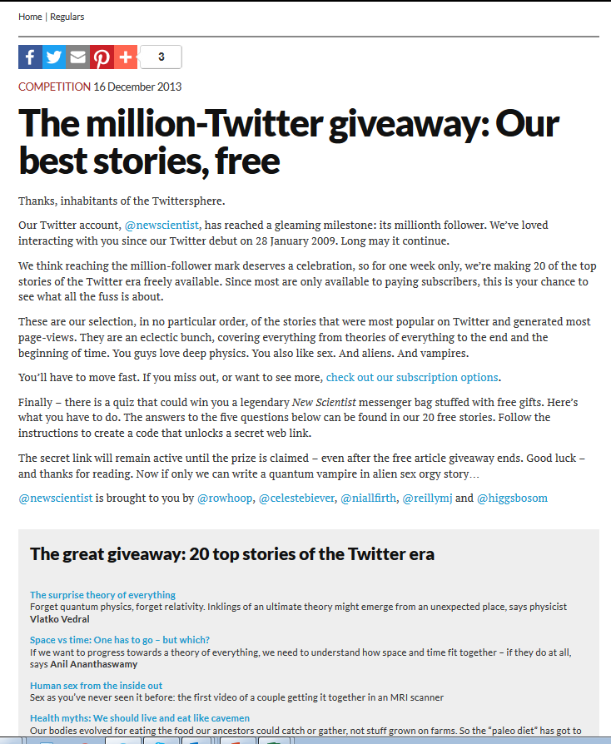
History
9,000 page views to this list
No demonstrable uplift in traffic
Competition won by

Slide 19
Competitive landscape
New Yorker – Summer of Free in 2014
http://www.niemanlab.org/2015/03/after-the-archive-came-down-the-new-yorkers-revamped-paywall-is-driving-new-readers-and-subscribers/
Boston Globe- Marathon bombing http://www.poynter.org/2013/bostonglobe-com-other-sites-drop-paywalls-for-marathon-coverage/210370/
FT – 1 month trial http://www.newyorker.com/news/john-cassidy/the-financial-times-and-the-future-of-journalism

Slide 20
ACTIONS
Web development prioritized for improving existing registered user experience – Rob/Lucy/Andy
  Login consistency
  My Account persuasion architecture
Web pass product is separate from any milestone social media promotions
  Facebook competition/ activity to be within Facebook specifically - Flora/Rowan
  Twitter competition/ activity to be within Twitter specifically - Flora/Rowan
Rob/Lucy/Andy to work on scope/timescales of creating a week free website pass
April 9th goal of launching a 1 week free website pass –with Migration cover content – messaging on free access related to content

